Slide 1
Real-time AI Fitness Monitoring System
Team：王绪龙 202230310264
王 昊 202230310262
裘罗荧 202230310247247
PPT汇

Slide 2
1
Background
2
Functional
CONTENTS
3
Technology Support
4
Project schedule

Slide 3
Background

Slide 4

Background
At present, people's demand for sports and fitness is increasing, and the application trend of health sports combined with high technology, online and big data is obvious. According to the Research report on China's Sports and Fitness Market in the third quarter of 2020, under the influence of the epidemic, residents' fitness and health issues have become a national social topic.So we decided to build a motion counting system to monitor our exercise.

Slide 5
Function

Slide 6
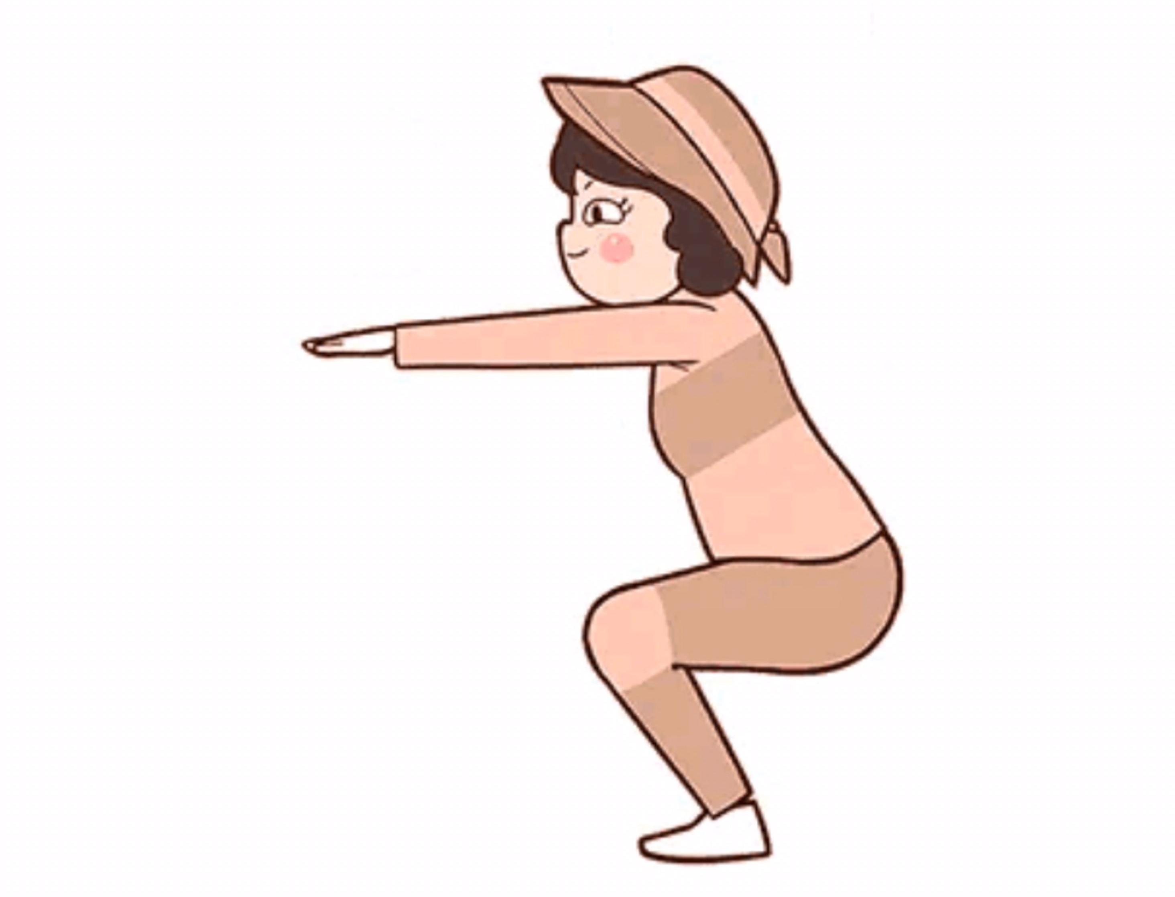
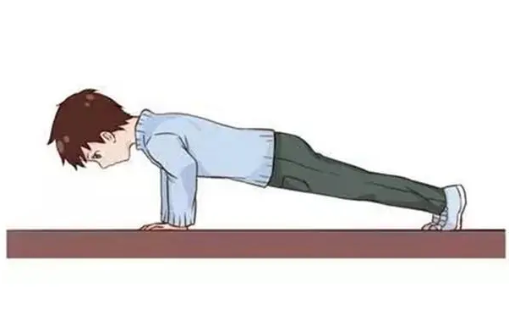
Function
Our system is a real-time fitness counting system, which can automatically tally user data or verify the quality of exercise performed and make real-time counts. Our system can count some exercises that do not require equipment, such as Push-up. The count can be done in real time by holding a phone in front of a portrait, making sure the whole body is visible and unshaded.
Push-up
deep squat

Slide 7
Technical Support

Slide 8
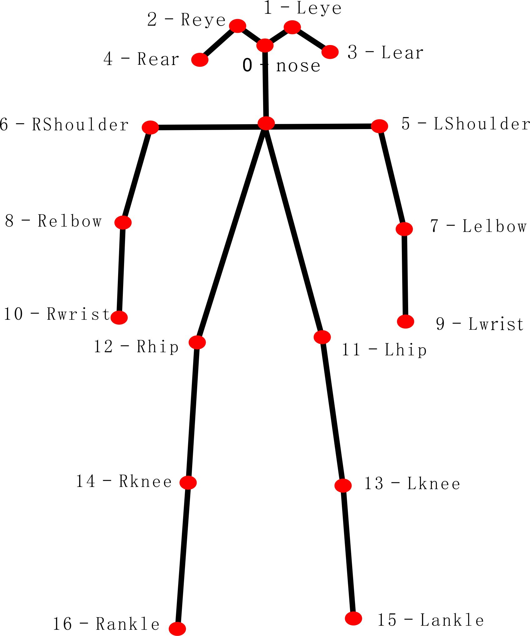
Introduction
There is an application branch of computer vision called Human Pose Estimation, which can estimate one or more people's attitude information in a key way，there are usually 17 key points. As shown in the picture on the right:
Notes:
In order to reduce the difficulty of algorithm development, the system only requires single-person pose detection. If the pose detection effect is good, then theoretically the counting of the exercise can be completed.
The counting rule is very simple: by observing the push-up posture, as long as the Euclidean distance between the key points representing the head and the key points representing the elbow changes periodically, it can be regarded as doing a push-up, and the frequency and period can be conveniently calculated for counting.
Therefore, the remaining problem is how to choose a model that can perform good pose detection quickly.

Slide 9
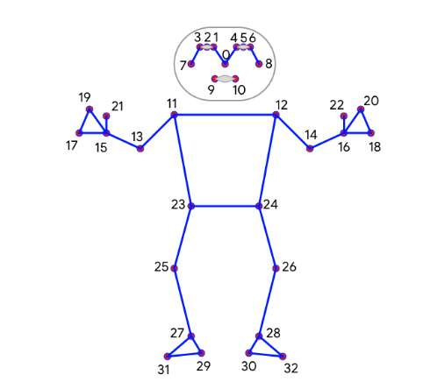
Technology Introduction
Mediapipe
Mediapipe is an open source project from google that provides open source, cross-platform common machine learning solutions. Mediapipe is actually an integrated tool library of machine learning visual algorithms, including face detection, face key, gesture recognition, avatar segmentation, and pose recognition models.
Examples of Mediapipe in action:
1) Face detection
2) FaceMesh
3) Portrait segmentation
4) Gesture recognition and tracking
5) Human posture recognition

Slide 10
Technology Introduction
KNN
K-NearestNeighbor as one of the simplest classification methods in data mining, it is widely used in classification, regression, pattern recognition and so on.
Advantages:
The problem of sample unbalance can be avoided by applying distance weight.
The algorithm is simple and easy to understand and implement.
Environment
Jupyter Notebook、Pycharm、python3.7、mediapipe0.8.10、Android Studio

Slide 11
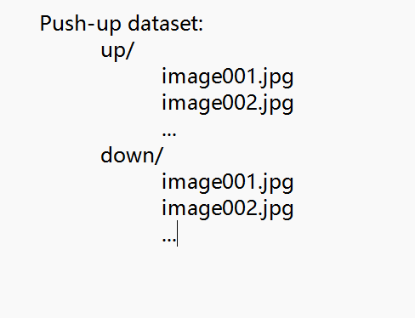
Dataset
Loading the dataset, the image should repeat the terminal state of the desired pose class.
to classify push-ups, you need to provide dimensions for two categories: when the person is up and when the person is down.
each class should have about dozens or hundreds of samples, covering different camera angles, environmental conditions, body shape and motion variations, to build a good classifier.
The dataset format is shown in the figure.

Slide 12
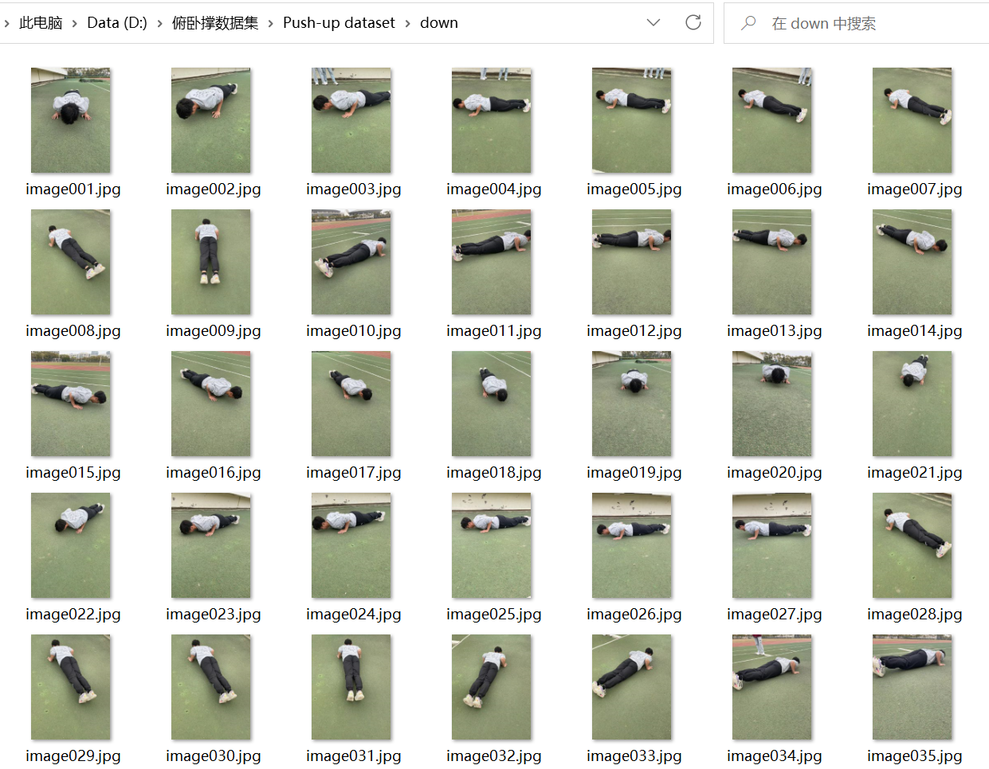
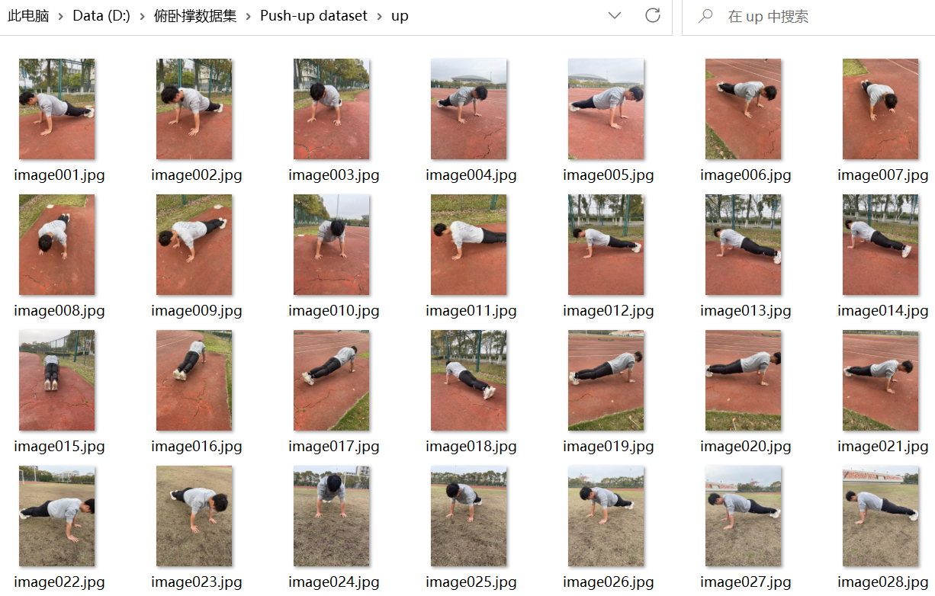
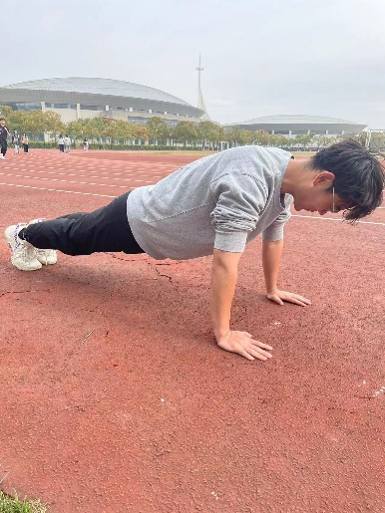
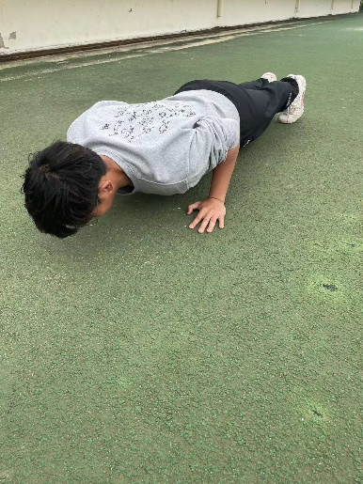
Dataset

Slide 13
Project schedule
Notes:
I will introduce some important points in our entire project, as well as our current and future work

Slide 14
Milestone
Milestone | Description
1.Data collection and annotation | Collect and annotate a push-up dataset.We took pictures and videos of ourselves doing push ups on the playground and used them as a dataset
2.Data preprocessing | Split each push-up frame into different segments, standardize and normalize the data for subsequent feature extraction and model training.
3.Feature extraction | Extract features from each segment of the push-up. Use the pose estimation model provided by MediaPipe to obtain the position of each key point and calculate features such as distance, angle, and velocity between them.
4. Model training | Train the model using the KNN algorithm. Split the dataset into training and testing sets, and use the training set to train the model. During training, choose an appropriate value of K and adjust the distance function to improve the accuracy and performance of the model.
5. Model testing and adjustment | After completing model training, test and adjust the model. Use the testing set to test the accuracy and performance of the model.
6. Develop the app interface and logic | After completing model training, start developing the app interface and logic. Decide how to present the counting results and progress, as well as how to control the display of push-up details such as the number of repetitions.
7. Integrate the model and app | After completing the development of the app, we need to integrate the trained KNN model into the app. Test and adjust the app to ensure that it can count accurately.

Slide 15
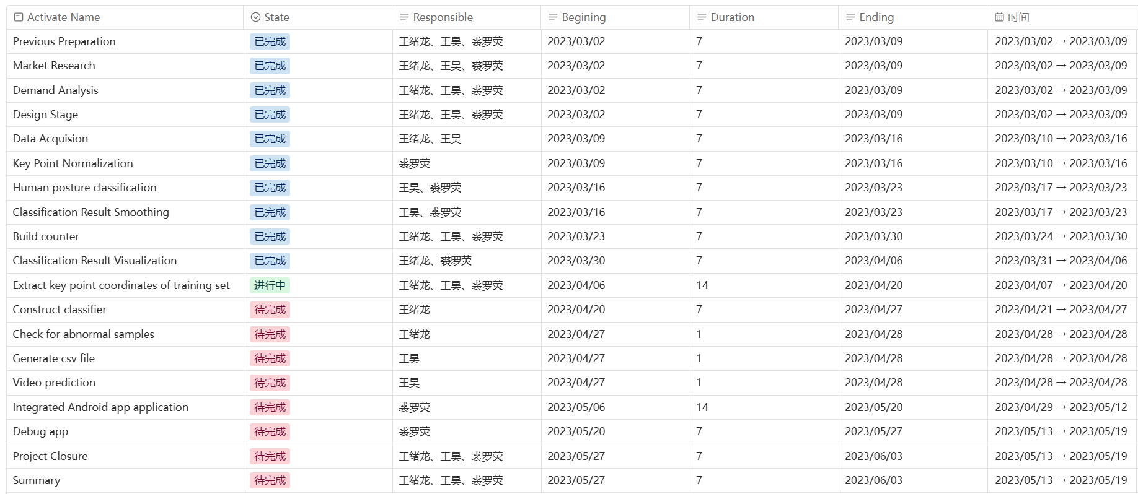
Project status and assignment of responsibilities
Notes:
After the previous work, we have been able to recognize some human postures and count functions on photos, but we are still unable to count our own push up videos. In the future, we will train our own dataset and combine them with the front-end to complete our project.

Slide 16
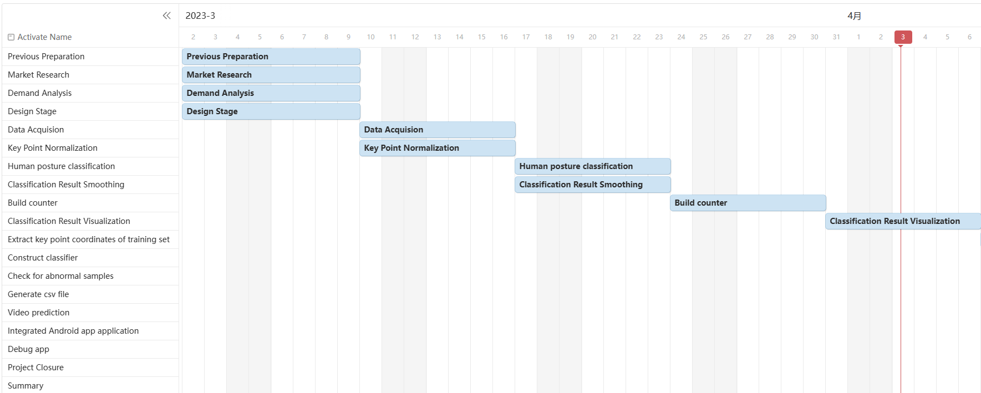
Gantt chart

Slide 17
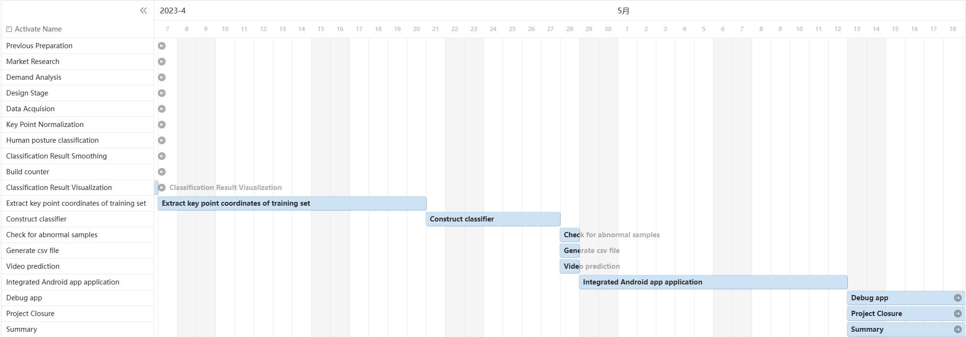
Gantt chart
Notes:
now，we are making our video into a datasets，which is a troublesome work， we should extract key points of training set and construct classifier，we are working hard。

Slide 18
Next work plan
Optimize the dataset by collecting more data.
1
Apply our trained model to the front-end and design some functions that are beneficial to users
2
Conduct user testing and collect feedback.Optimize the application based on feedback and results from user testing.
3
Notes:
These are just some plans for the later stage. We are preparing to complete the first two stages. If there is time, we will conduct some surveys on a wider range of users and receive some feedback to make corrections

Slide 19
Thank You!

